Slide 1
Project Presentation of Back End Engineering Project (BEE) (22CS026)
On
Job Portal
Pawan Gambhir 2210992035
Prachi Jain 2210992054
Prerana Thakur 2210992085
Supervised By:
Mr. Rahul Singh
Department of Computer Science and Engineering,
Chitkara University, Punjab

Slide 2
Introduction
Project Title: Job Portal
In today’s competitive job market, finding the right job or the ideal candidate can be a challenging and time-consuming process. Our job portal aims to bridge this gap by offering an efficient, user-friendly platform designed to streamline job searches and recruitment efforts.
Purpose:
The primary purpose of our job portal is to connect job seekers with suitable job opportunities and help employers identify and hire the best candidates based on their qualifications, experience, and skill sets. By leveraging advanced search algorithms, intuitive user interfaces, and comprehensive job matching features, our platform seeks to make the job search and recruitment process more efficient and effective for both job seekers and employers.

Slide 3

Problem Statement
For Job Seekers:
Job seekers often face an overwhelming number of job listings, making it difficult to find relevant positions that match their skills and interests. Many existing job portals provide generic job recommendations that do not align with the job seeker’s specific qualifications or career goals. The application process can be cumbersome, with lengthy forms and multiple steps that deter job seekers from completing applications.
For Employers:
Employers struggle to find candidates who meet their specific job requirements due to inadequate filtering and search options. Traditional recruitment methods can be expensive and time-consuming, impacting the overall efficiency of the hiring process. Employers often lack comprehensive insights into candidates’ skills and experiences, leading to less informed hiring decisions.

Slide 4
Objectives
Efficient Data Management: Develop a robust backend system to handle job listings, user profiles, applications, and employer details efficiently.
Scalable Architecture: Build a scalable backend that can handle increasing amounts of data and traffic as the platform grows.
Secure Data Handling: Ensure that user and employer data is stored securely and managed in compliance with privacy regulations.
Fast and Reliable Performance: Create a backend that provides quick responses to user queries and supports a seamless user experience.

Slide 5
Features
Job Listings Management:
CRUD Operations: Enable Create, Read, Update, and Delete operations for job listings, allowing employers to post, modify, and remove job ads.
User Profile Management:
Profile Creation: Allow job seekers and employers to create and manage their profiles, including personal information, skills, experience, and job preferences.
Profile Updates: Enable users to update their profiles and keep their information current.
Company Profile Management:
Profile Creation: Allow job companies to create and manage their profiles, including name, information, skills, experience, salary and position.
Profile Updates: Enable companies to update their profiles and keep their information current.
Authentication and Authorization:
User Authentication: Implement secure login and registration processes for job seekers and employers.
Role-Based Access Control: Ensure that different types of users (job seekers and employers) have appropriate access levels and permissions.

Slide 6
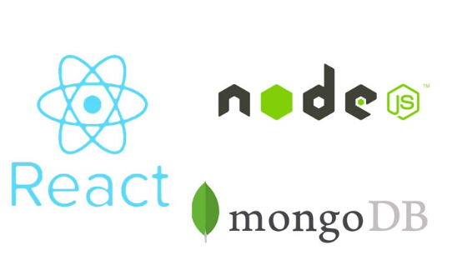
Technical Details
Node.js, Express.js
For handling server-side logic and APIs.
MongoDB, Mongoose
For storing data from user and recruiter’s end.

Slide 7
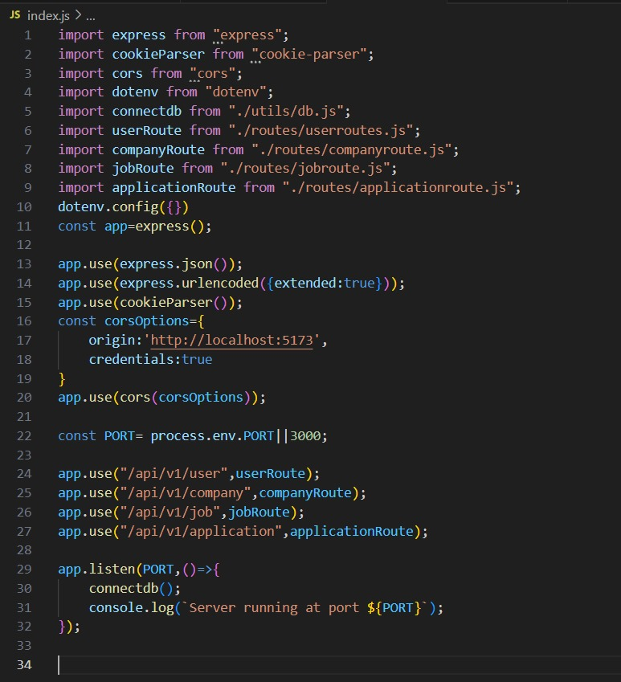
Code Implementation

Slide 8
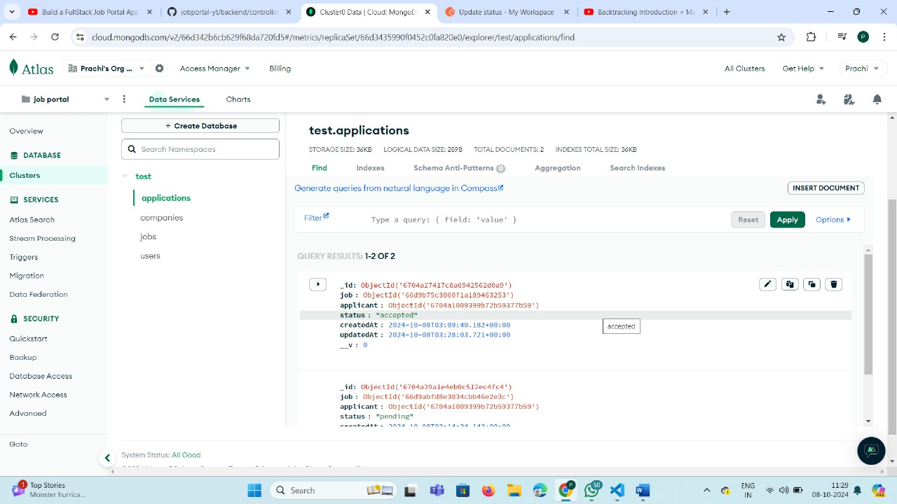

Slide 9
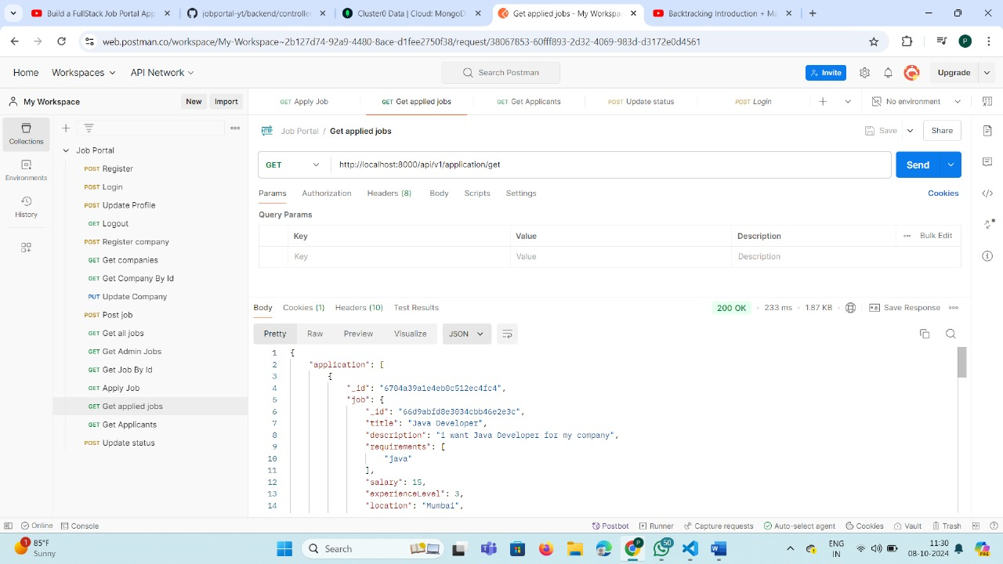

Slide 10
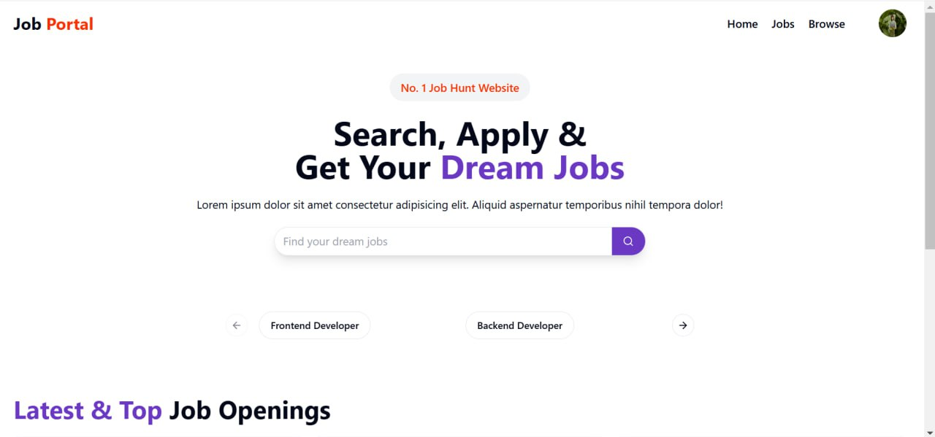

Slide 11
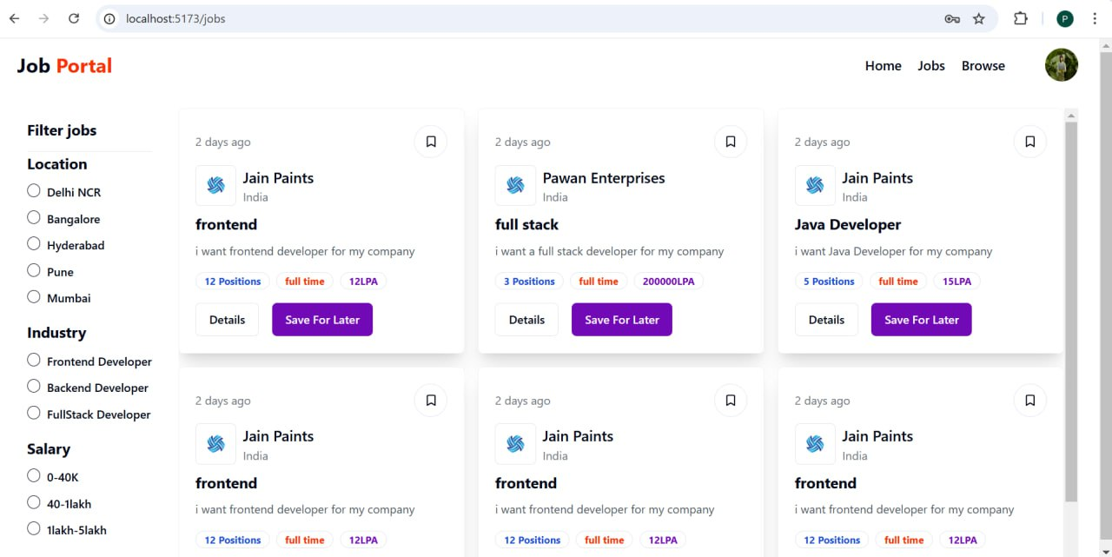

Slide 12
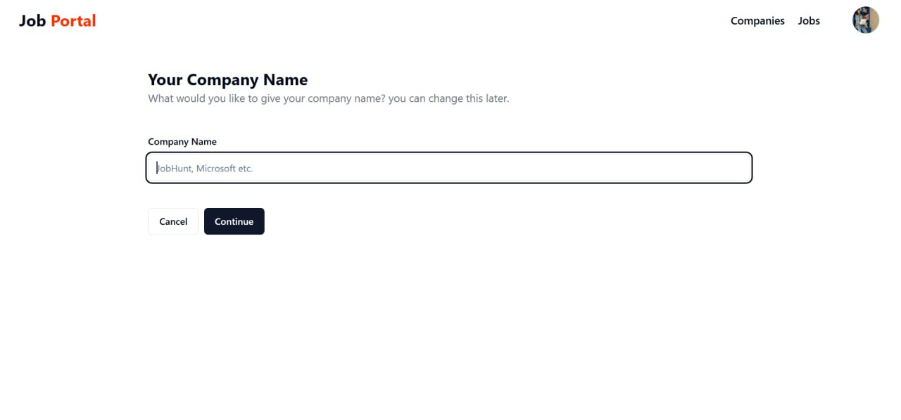

Slide 13
Advantages
Centralized Control: A well-designed backend allows for centralized management of job listings, user profiles, and applications, ensuring data consistency and integrity.
Organized Data Storage: Structured storage solutions help in organizing data efficiently, making it easier to retrieve and manage information.
Handling Growth: A scalable backend can accommodate increasing amounts of data and user traffic without compromising performance, supporting the growth of the platform.
Data Protection: Implementing robust security measures protects sensitive user information from unauthorized access and breaches.
Fast Response Times: Efficient backend logic and optimized database queries contribute to quick response times, enhancing the overall user experience.
Reliability: A reliable backend ensures that the platform remains operational and performs consistently, minimizing downtime and disruptions.

Slide 14
Future Scope
Optimize for larger datasets and multi-threaded operations to improve scalability.
Strengthen authentication and authorization mechanisms for enhanced security.
Implement multi-language support to attract a diverse user base.
Add real-time notifications for job updates and applications.
Integrate payment gateways for premium features such as highlighted job posts.

Slide 15
Thank You
15

